Slide 1
CMP-262 Final Project
Matthew Moskal

Slide 2
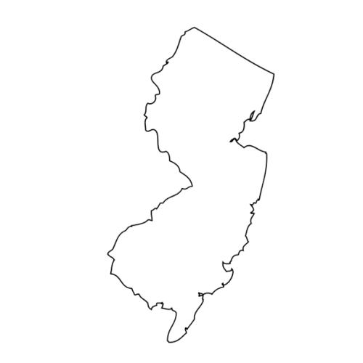
Introduction
New Jersey fishermen have been catching less than ever
Large fishing vessels off of the coast are still pulling in massive amounts of fish
The dwindling fish populations on the Jersey Shore due to local overfishing sparked curiosity
How do significant fishing effort statistics look when seeing them from a worldwide perspective, and what trends can I observe?

Slide 3
Who Does My Research Help?
Fishermen
Activists
Conservation Societies
Everyday people can get a better insight into how fish are caught across the world, realize just how big the problem of overfishing is globally, and take action.
The same as fishermen can realize the problem of mass overfishing, so can activists who can petition and protest against the continuation of harmful fishing practices.
With a better look into how international fishing really scales, efforts can be initiated to curb possible harmful effects of the practice.

Slide 4
Dataset Selection / Methodology
CSV dataset selected from organization Global Fishing Watch
700,000+ vessel data entries analyzed via experts and machine learning algorithms
Was able to work with individual vessel data like tonnage, flag, vessel type, and length.
Tools used included Python Jupyter Notebooks with packages such as Numpy, Pandas, and MatPlotLib

Slide 5
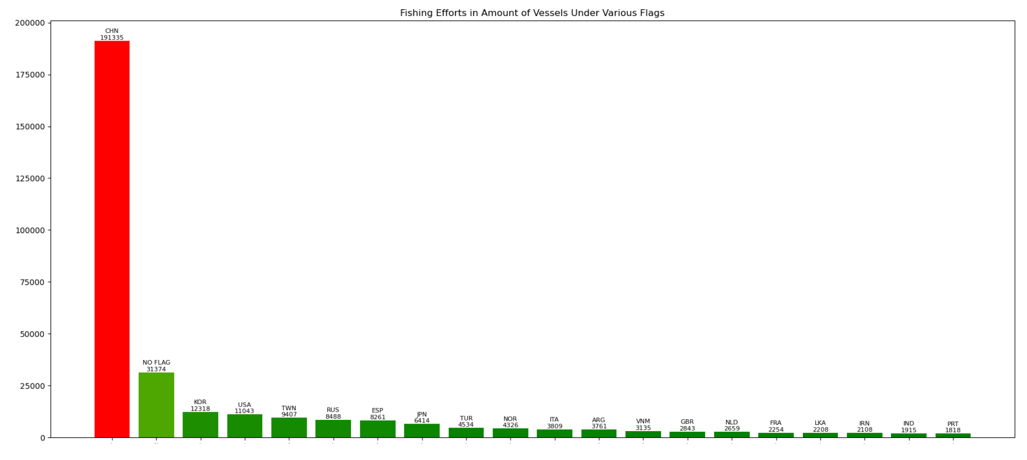
Question 1
What countries are out there fishing? Are there countries that have a large share in global fishing efforts?
China leads by an incredible margin
Large amount of unflagged vessels still fishing
Steep drop off in vessel numbers after those 2 categories

Slide 6
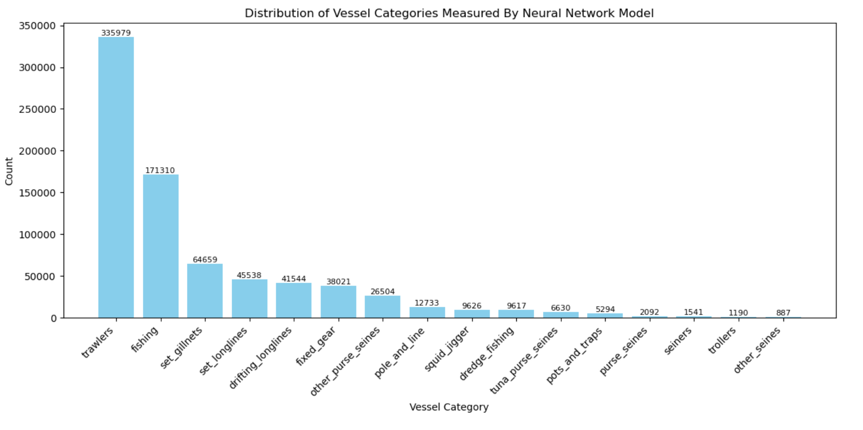
Question 2
What types of fishing are going on? My dataset contains fishing vessel types, and I want to know what categories they fall into.
Trawlers are by far the most dominant vessel type
Extremely efficient but destructive fishing method
Besides general fishing vessels other categories lag behind

Slide 7
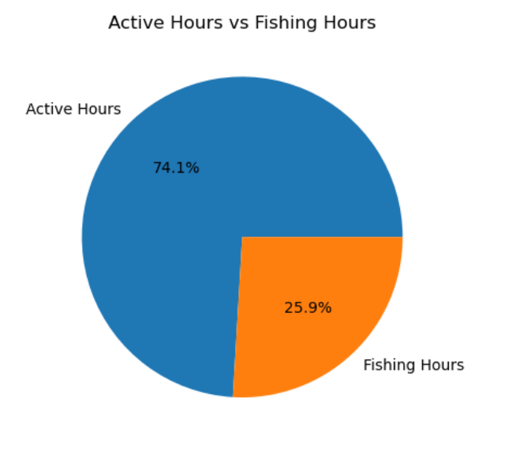
Question 3
What is the percentage split of the amount of active hours vs the amount of fishing hours over this dataset?
Mass fishing is not as effective as I thought
Almost a 75/25 split of fishing downtime to actual fishing time
Has to do with overfishing of coastal waters, pushing fishing further from shore

Slide 8
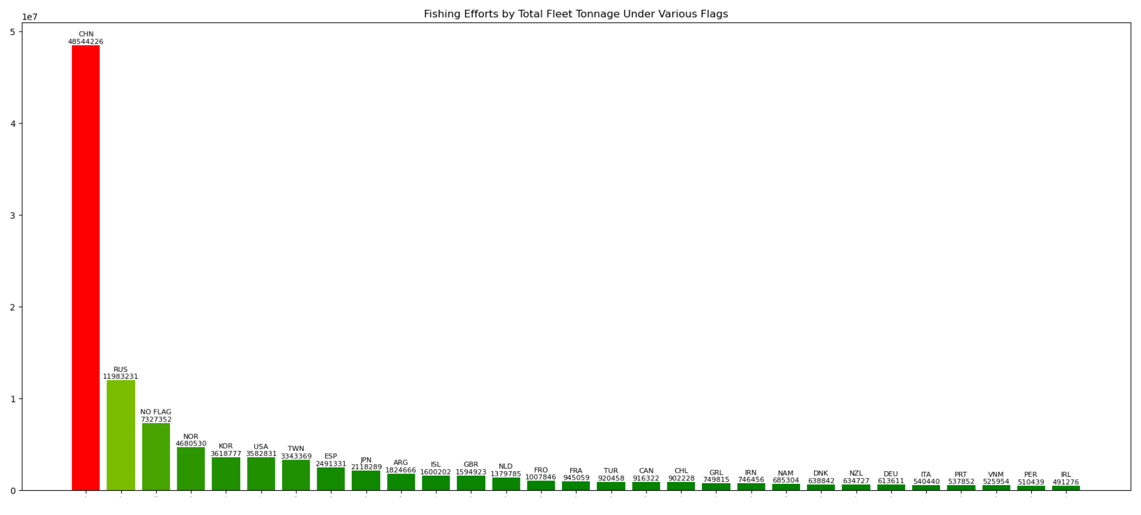
Question 4
What are the gross tonnage totals for each country's fishing fleet?
Discrepancy between fleet tonnage and size
Has to do with the type of fish being targeted due to the waters of the country
Fleet size isn’t the only problem here

Slide 9
Future Work
Want to connect my findings a dataset that can visualize what types of fish are being caught around the world and in what numbers
Will allow me to strengthen my argument of the extreme scale of industrialized fishing and its harmful effects
Could bring more awareness to my topic

Slide 10
Dataset Selection / Methodology
CSV dataset selected from organization Global Fishing Watch
700,000+ vessel data entries analyzed via experts and machine learning algorithms
Was able to work with individual vessel data like tonnage, flag, vessel type, and length.
Tools used included Python Jupyter Notebooks with packages such as Numpy, Pandas, and MatPlotLib

Slide 11
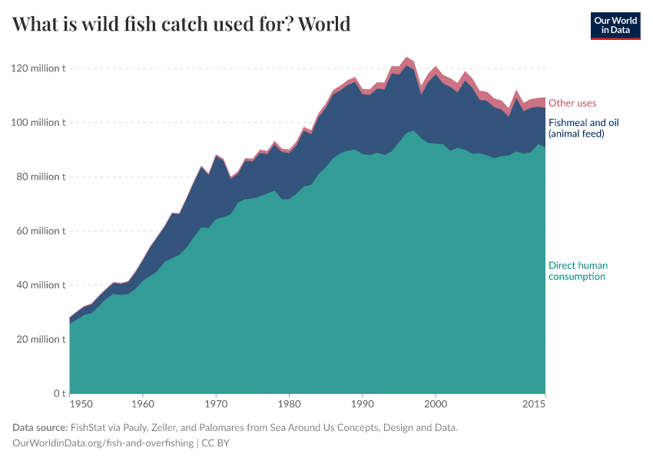
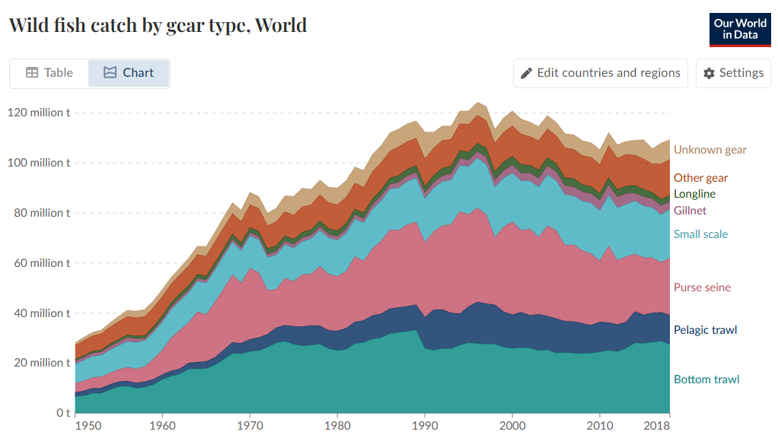
Appendix
Additional Graphs Showing the Rise of Mass Fishing
Source: Our World in Data

